Slide 1
Quality Control in the Fashion Industry
Carol Hanlon, GAICD, MIEF

Slide 2
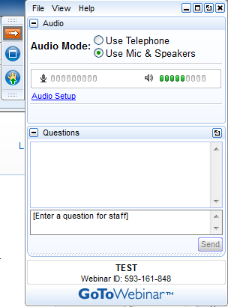
Housekeeping for this Webinar
You may ask any questions that you have during a LIVE session by submitting them to the presenter via the questions panel.
Type your question and click Send to submit it to the presenter.
NOTE: The presenter will answer any questions at the conclusion of the presentation.
Cannot see the questions Panel?
The GoToWebinar toolbar may be minimised. Please select the orange arrow to maximise the toolbar.
In a recorded session please email your question after the session has concluded.
For further assistance please contact
61 8 9479 3777

Slide 3
What is Quality Control ?
Quality control is ensuring you receive the best quality of production to deliver to your customers - the retailers.
There are many aspects to quality control which will enable you to achieve this end goal.
The main key to this success lies in your choice and workability with your chosen manufacturer.
It is your responsibility as a designer/business owner to take total responsibility of the quality control of your production run.

Slide 4
Quality Control Framework
Owner co-ordinates and controls production and adheres to own standards.
Fabrics and trims checked on premises.
Samples made in stages and checked by owner/quality controller.
Cutting room supervisor checks patterns and checks against lay slip.
Production floor meeting including production manager and quality controller before production begins.
Continual quality controlling throughout production as put in place prior to production run as per your standard.
Delivery check to be completed by owner/quality controller and faults to be classified as critical, serious or minor.
Visit your standards put in place to rectify issues.

Slide 5
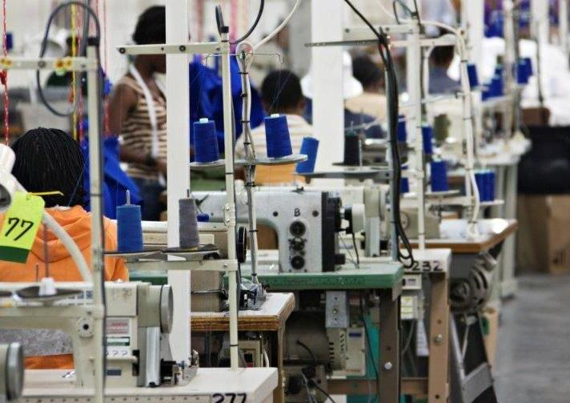
Choosing your Manufacturer Wisely
Choose the right manufacturer for the product.
Communicate your expectations effectively.
Be very clear and provide factory with all the tools to produce your product accurately.
Communicate regularly.
Communicate without emotion getting the better of you.
Keep working on developing a good relationship.

Slide 6
Quality Control Standards
Set standards to ensure the following areas are covered.
After cutting and first garment is sewn check production.
Visit the manufacturer regularly.
If unsatisfied with what you find discuss immediately and listen to response to see it is able to be resolved quickly.
Be aware of which stage the manufacturer is at throughout the manufacturing run.
Use your specification sheet and quality control checklist to verify all is as it should be.

Slide 7
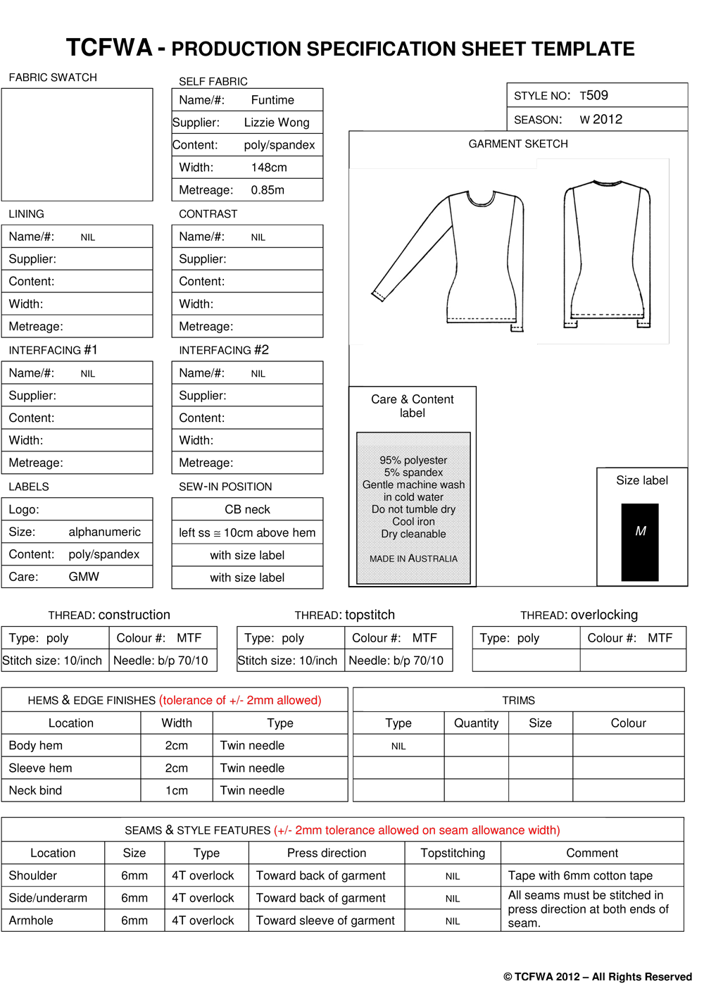
Production Specification Sheet - Template

Slide 8
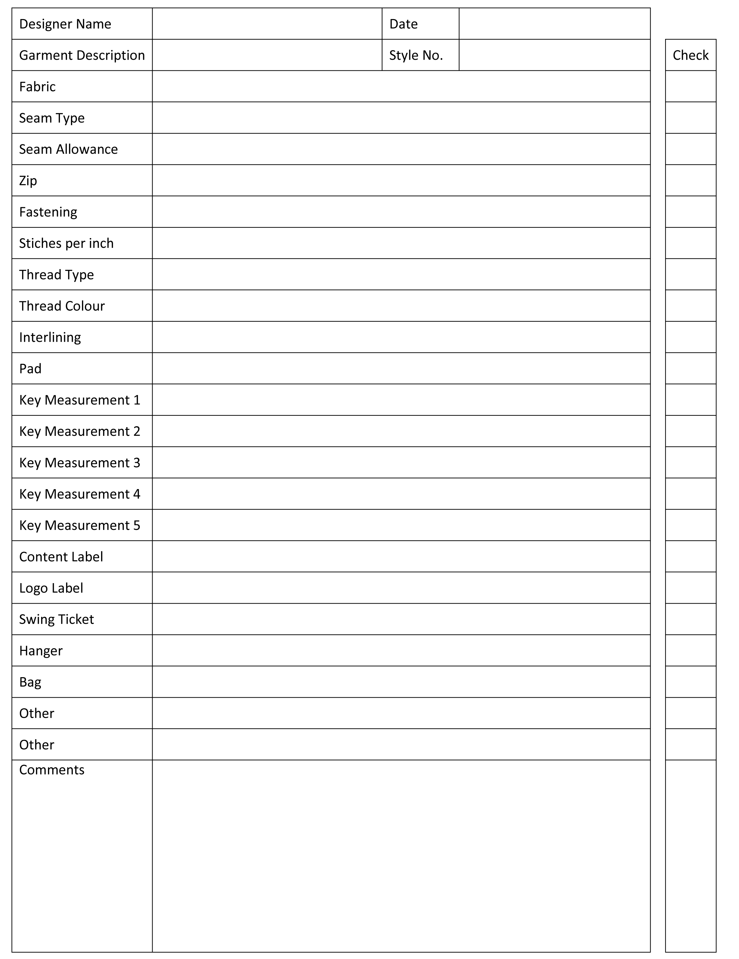
Quality Control Checklist & What to Look for

Slide 9
Fabric Issues
Check all fabric quality on delivery.
Check all fabric metreage on delivery.
Once fabric is cut the manufacturer will not compensate you.
If you decide to salvage parts of the fabric and cut around the damaged areas keep all damaged fabric to show fabric supplier and report immediately.

Slide 10
Some Common Fabric Issues
Some common fabric issues to look for include:
Askewed or bias – filling yarns not square
Back fabric seam impression
Barre - appears to have horizontal streak
Broken colour pattern
Colour out
Colour smear
Crease mark
Drop stitches
Dye streak or printing
Holes

Slide 11
What to do if Manufacturing is Unsatisfactory
Manufacturer must agree there is an issue
Ask manufacturer how to fix it
Fix one piece only and see how it looks
If delays will occur contact your customers immediately to agree on a new delivery time

Slide 12
Dispute Resolution Options
Work closely with manufacturer or fabric supplier to solve the issue and then agree upon a fair resolution
Take legal action if this fails
Move on,
absorb costs
and start again

Slide 13
Minimising Quality Control Issues
Build a relationship with your manufacturer and suppliers.
Set standards and adhere to them.
Be clear with your expectations.
Give thorough specification sheets.
Use a thorough quality control checklist.
Be in touch frequently.
Set guidelines for visiting the manufacturer throughout the production run.
Be proactive with any issues that arise.
Keep a cool head.
At the end of production run meet to discuss issues.
Amend specification sheets, quality control checklist etc if they can be improved upon.

Slide 14
Additional Belmont BEC TCF Australia Resources
View upcoming www.belmontbec.com/webinars
LIVE or Recorded Webinars
Advisors, Mentors, Coaches also available to book ONLINE by hour - one/one
Join www.tcfaustralia.com/membership
Events, Opportunities and Support
Suggested Topics :
Pricing, Costing, Cash Flow
Business Planning
Marketing for Small Fashion Apparel Businesses
Goal Setting, SWOT and Self Assessment of Business Skills
Avoiding Manufacturing Pitfalls
Specification Sheets
What Buyers are Really Looking For
Strategies for Successful Sourcing

Slide 15
Presented by
Street Address: 7 Fairbrother Street Belmont WA 6104 Australia
Postal Address: PO Box 370 Cloverdale WA 6985 Australia
Phone: +61 8 9479 3777 | Fax: +61 8 9479 3888
Email: support@tcfaustralia.com
www.tcfwa.com.au | www.tcfaustralia.com | www.tcfglobal.com

